Slide 1
Neural Networks Learning
Author:
Yan-yang Lee(blamedrlee@outlook.com)

Slide 2
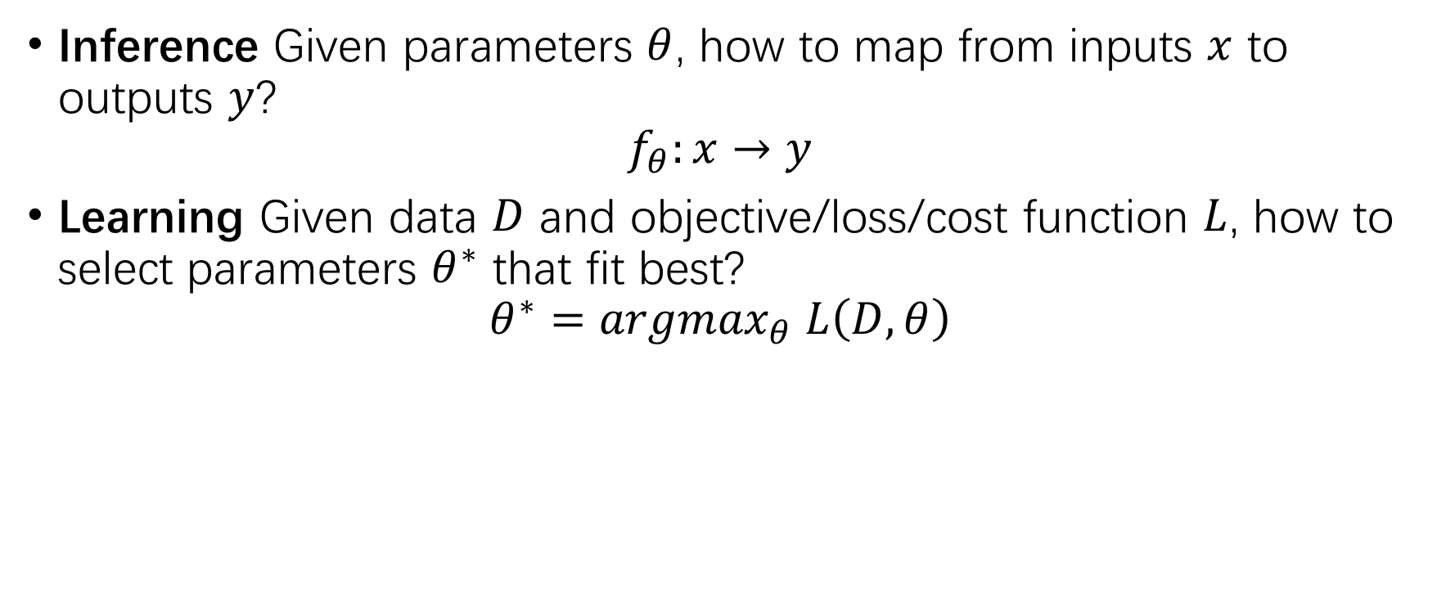
Two Main Tasks for Neural Networks
Inference Given parameters $θ$, how to map from inputs $x$ to outputs $y$?
$$f_{θ}:x→y$$
Learning Given data $D$ and objective/loss/cost function $L$, how to select parameters $θ^{∗}$ that fit best?
$$θ^{∗}={argmax}_{θ} L\left(D,θ\right)$$

Slide 3
Contents
Principles to Design Objective Function: P4
Key Features of Iterated Learning Process: P5
Optimization Methods Overview: P6-15
Computing Gradients - Back Propagation: P16-17
Tricks/Enhancements to Speed Up GD: P18-27
Two Ways to Inject Priors in GD: P28

Slide 4
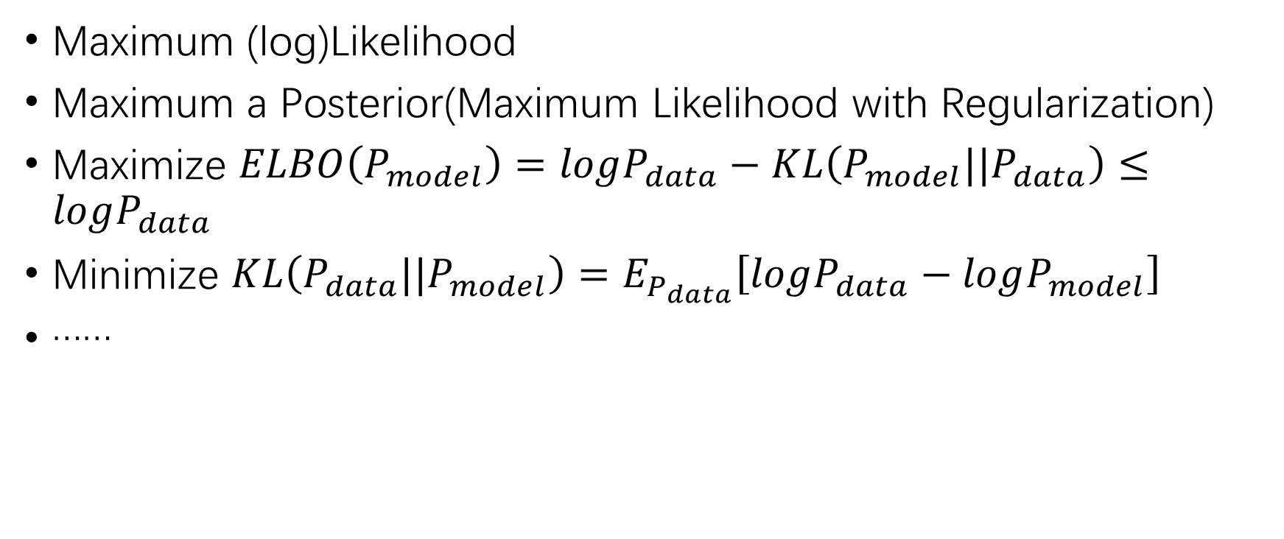
Principles to Design Objective Function
Maximum (log)Likelihood
Maximum a Posterior(Maximum Likelihood with Regularization)
Maximize $ELBO\left(P_{model}\right)=logP_{data}−KL\left(P_{model}||P_{data}\right)≤logP_{data}$
Minimize $KL\left(P_{data}||P_{model}\right)=E_{P_{data}}\left[logP_{data}−logP_{model}\right]$
……

Slide 5
Key Features of Iterated Learning Process
Existence of a good model: Whether a unique global optima in objective function existed and corresponds to a good model?
Possibility of getting a good model: Whether the algorithm will converge?
Consistence/Effectiveness of update rule(learning dynamic): How (fast) the algorithm will converge?

Slide 6
Optimization Methods Overview
Non-Gradient based Methods
Pretraining
Evolution Strategy/Genetic Algorithm
Simulated Annealing: P7-8
Simplex
Gradient based Methods
Gradient Descent: P9-12
Newton’s Method: P13-15
Meta Learning

Slide 7
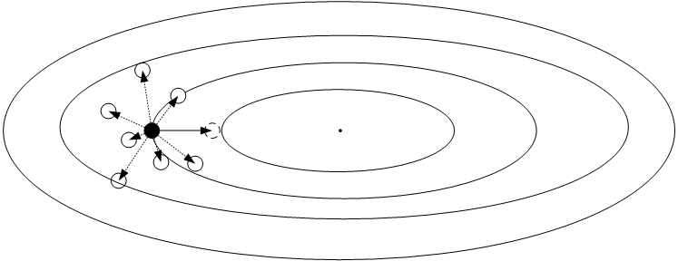
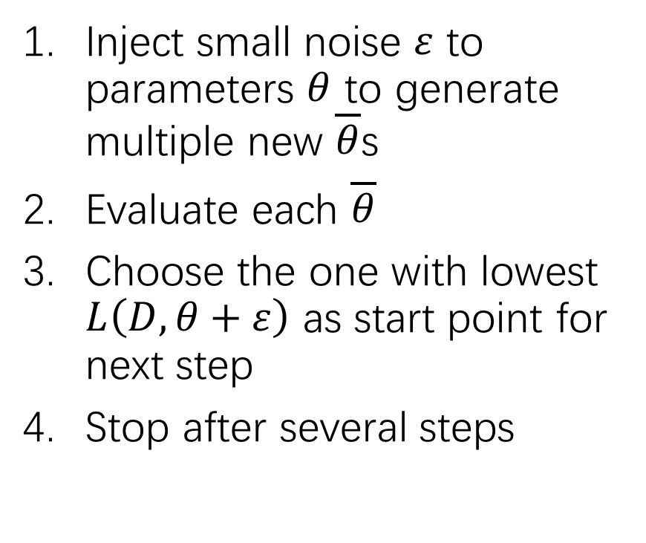
Evolution Strategy - Discretion
Inject small noise $ε$ to parameters $θ$ to generate multiple new $\overline{θ}$s
Evaluate each $\overline{θ}$
Choose the one with lowest $L\left(D,θ+ε\right)$ as start point for next step
Stop after several steps

Slide 8
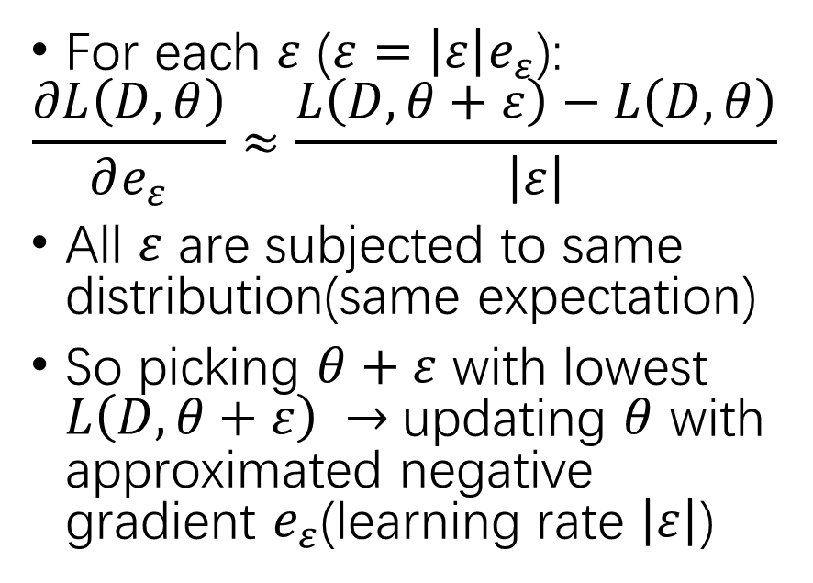
Evolution Strategy - Analysis
Relation to GD
Advantages
For each $ε$ ($ε=\left|ε\right|e_{ε}$):
$$\frac{∂L\left(D,θ\right)}{∂e_{ε}}≈\frac{L\left(D,θ+ε\right)−L\left(D,θ\right)}{\left|ε\right|}$$
All $ε$ are subjected to same distribution(same expectation)
So picking $θ+ε$ with lowest $L\left(D,θ+ε\right) →$updating $θ$ with approximated negative gradient $e_{ε}$(learning rate $\left|ε\right|$)
Model can be a black box
Highly parallelizable
Do not require model to be differentiable
Simple implementation

Slide 9
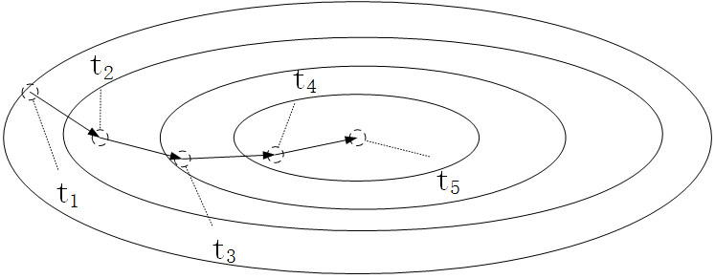
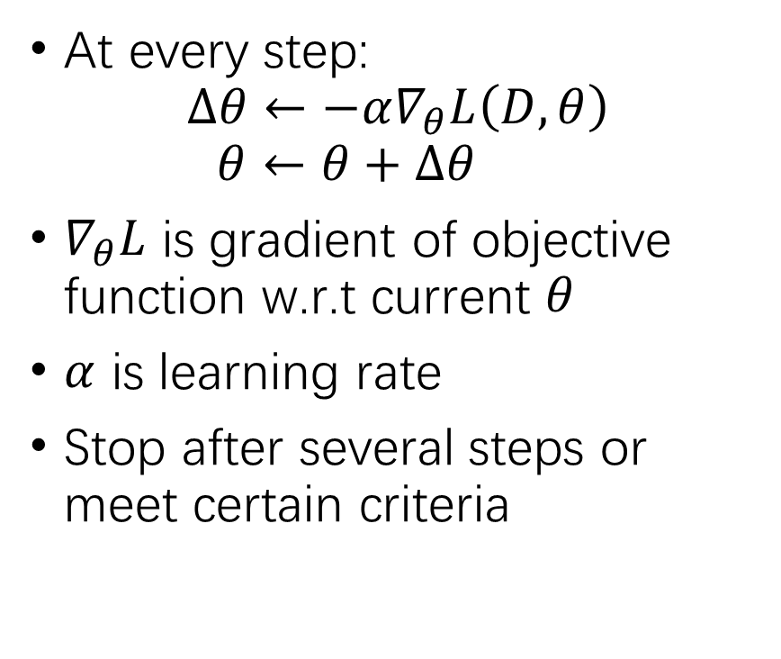
Gradient Descent - Discretion
At every step:
$$∆θ←−α∇_{θ}L\left(D,θ\right)$$
$$θ←θ+∆θ$$
$∇_{θ}L$ is gradient of objective function w.r.t current $θ$
$α$ is learning rate
Stop after several steps or meet certain criteria

Slide 10
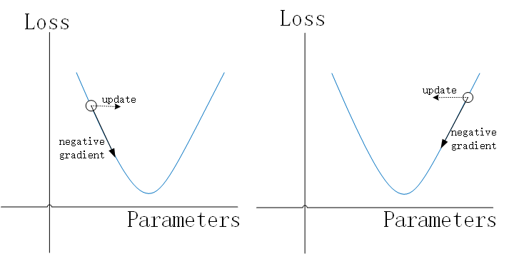
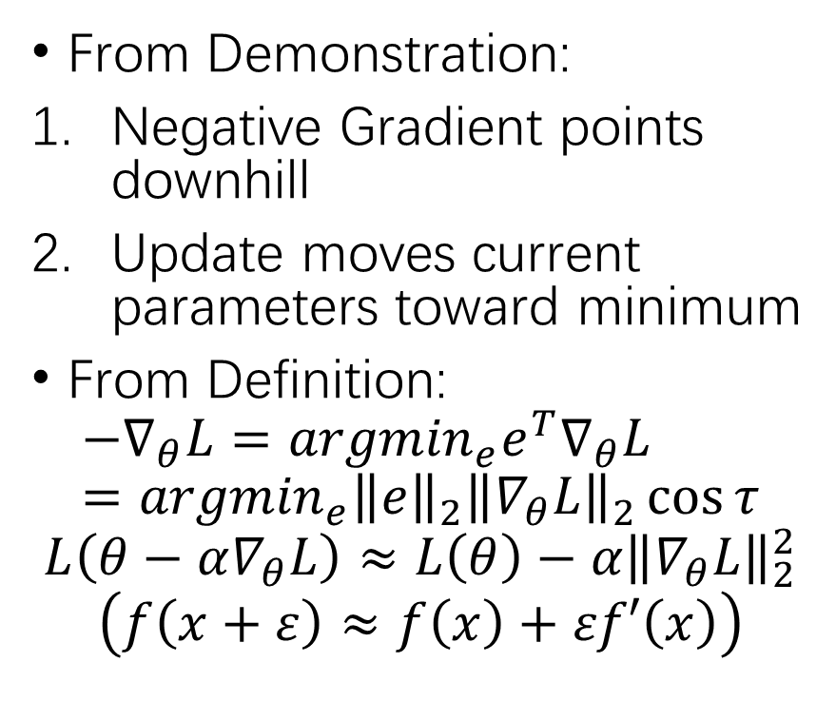
Gradient Descent - Why GD works?
From Demonstration:
Negative Gradient points downhill
Update moves current parameters toward minimum
From Definition:
$$−∇_{θ}L={argmin}_{e}e^{T}∇_{θ}L={argmin}_{e}{\left\|e\right\|}_{2}{\left\|∇_{θ}L\right\|}_{2}\cos{τ}$$
$$L\left(θ−α∇_{θ}L\right)≈L\left(θ\right)−α{\left\|∇_{θ}L\right\|}_{2}^{2}$$
$$\left(f\left(x+ε\right)≈f\left(x\right)+εf′\left(x\right)\right)$$

Slide 11
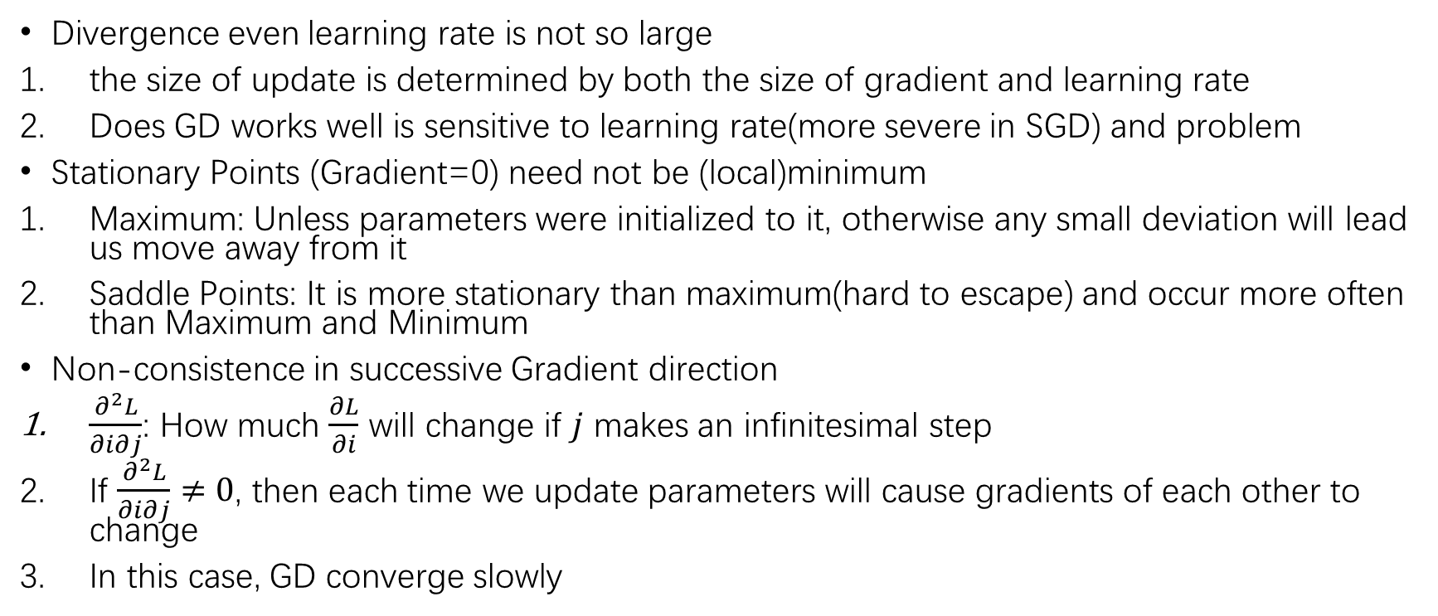
Gradient Descent - Crucial Points
Divergence even learning rate is not so large
the size of update is determined by both the size of gradient and learning rate
Does GD works well is sensitive to learning rate(more severe in SGD) and problem
Stationary Points (Gradient=0) need not be (local)minimum
Maximum: Unless parameters were initialized to it, otherwise any small deviation will lead us move away from it
Saddle Points: It is more stationary than maximum(hard to escape) and occur more often than Maximum and Minimum
Non-consistence in successive Gradient direction
$\frac{∂^{2}L}{∂i∂j}$: How much $\frac{∂L}{∂i}$ will change if $j$ makes an infinitesimal step
If $\frac{∂^{2}L}{∂i∂j}≠0$, then each time we update parameters will cause gradients of each other to change
In this case, GD converge slowly

Slide 12
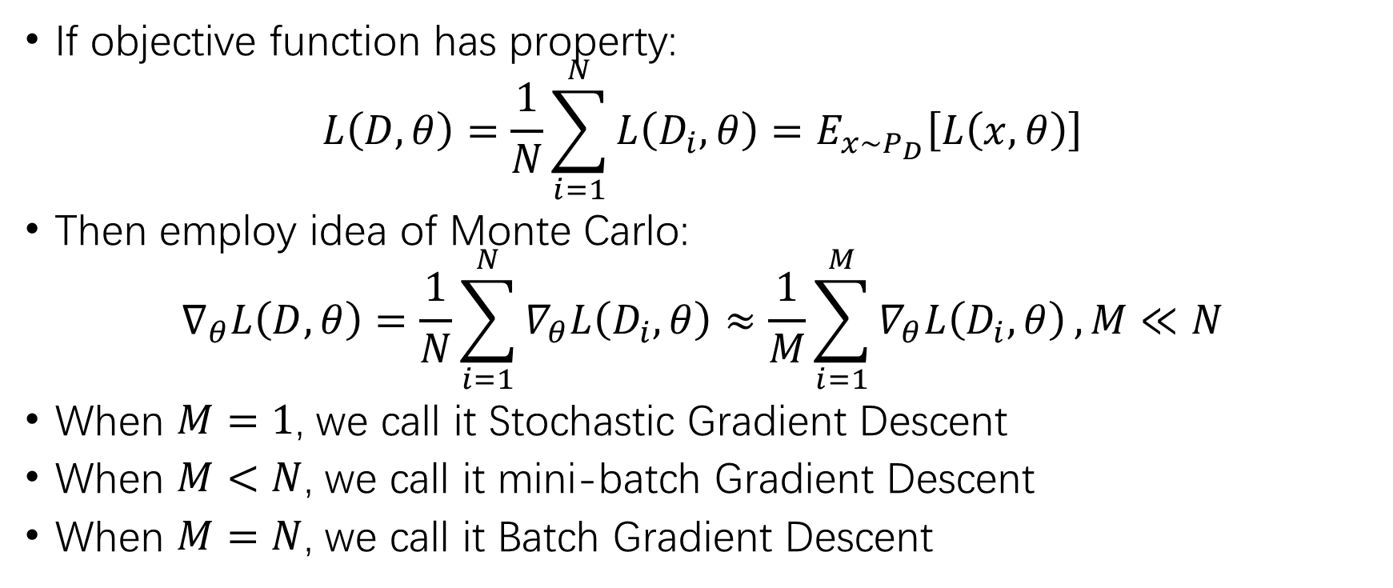
Stochastic Gradient Descent(SGD)
If objective function has property:
$$L\left(D,θ\right)=\frac{1}{N}\sum_{i=1}^{N}{L\left(D_{i},θ\right)}=E_{x\sim P_{D}}\left[L\left(x,θ\right)\right]$$
Then employ idea of Monte Carlo:
$$∇_{θ}L\left(D,θ\right)=\frac{1}{N}\sum_{i=1}^{N}{∇_{θ}L\left(D_{i},θ\right)}≈\frac{1}{M}\sum_{i=1}^{M}{∇_{θ}L\left(D_{i},θ\right)},M≪N$$
When $M=1$, we call it Stochastic Gradient Descent
When $M<N$, we call it mini-batch Gradient Descent
When $M=N$, we call it Batch Gradient Descent

Slide 13
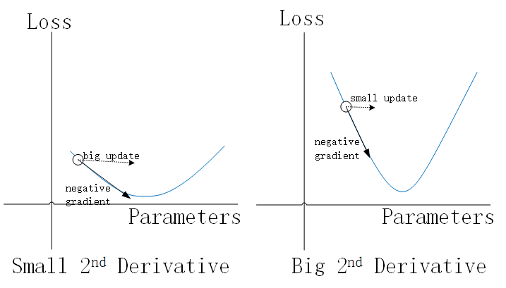
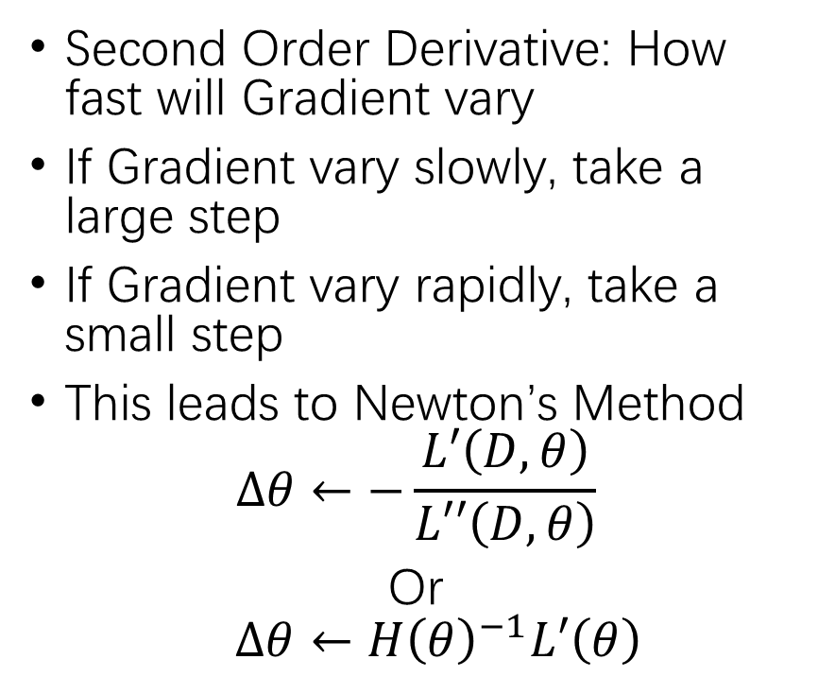
Newton’s Method - Motivation
Second Order Derivative: How fast will Gradient vary
If Gradient vary slowly, take a large step
If Gradient vary rapidly, take a small step
This leads to Newton’s Method
$$∆θ←−\frac{L′\left(D,θ\right)}{L′′\left(D,θ\right)}$$
Or
$$∆θ←{H\left(θ\right)}^{−1}L′\left(θ\right)$$

Slide 14
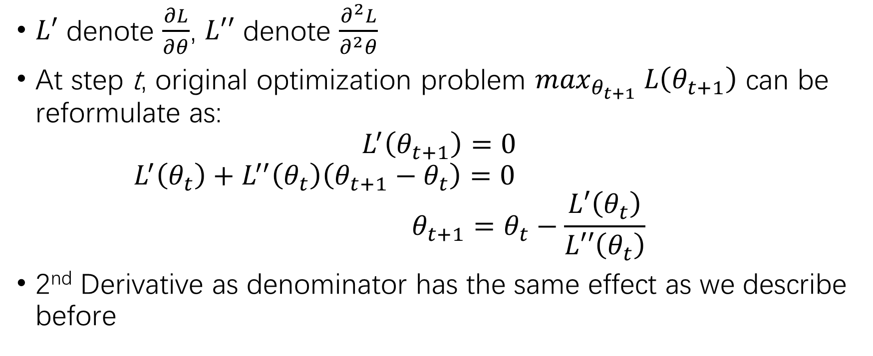
Newton’s Method - Derivation
$L′$ denote $\frac{∂L}{∂θ}$, $L′′$ denote $\frac{∂^{2}L}{∂^{2}θ}$
At step t, original optimization problem $\max_{θ_{t+1}} L\left(θ_{t+1}\right)$ can be reformulate as:
$$L^{′}\left(θ_{t+1}\right)=0$$
$$L^{′}\left(θ_{t}\right)+L^{′′}\left(θ_{t}\right)\left(θ_{t+1}−θ_{t}\right)=0$$
$$θ_{t+1}=θ_{t}−\frac{L′\left(θ_{t}\right)}{L′′\left(θ_{t}\right)}$$
2nd Derivative as denominator has the same effect as we describe before

Slide 15
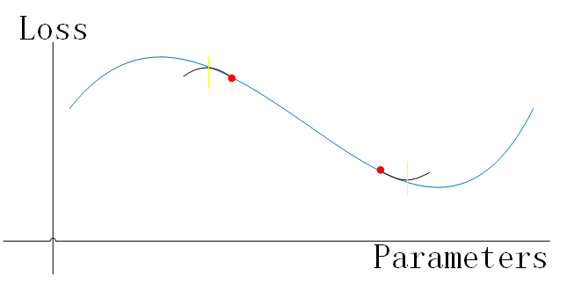
Newton’s Method - Drawbacks
NM directly solves optima (Gradient=0) of 2nd approximation of objective function
When we close to minima, such optima will be minima
Yet when we close to maxima, such optima will be maxima
We can fix this by make the sign of 2nd derivative consisted with Gradient’s.

Slide 16
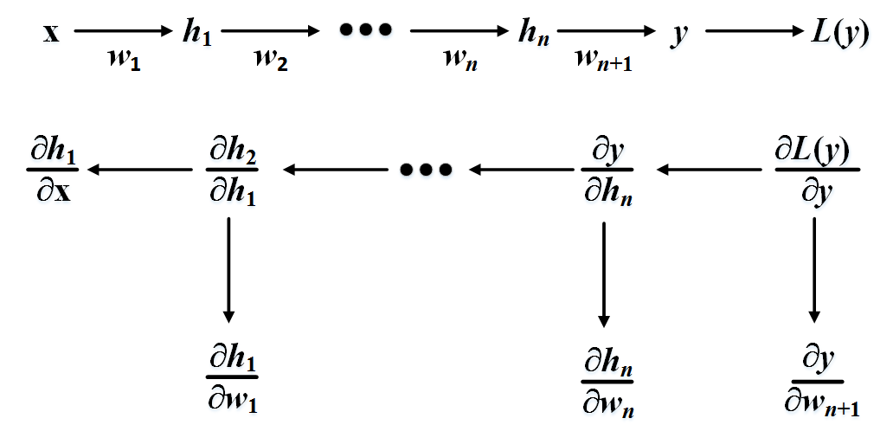
Back Propagation – Chain Rule

Slide 17
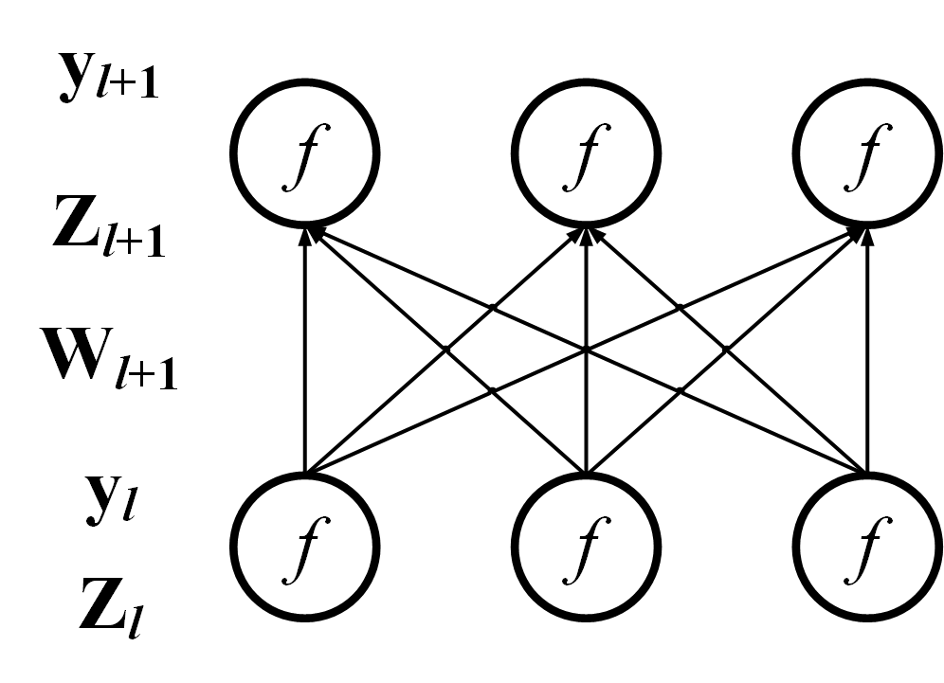
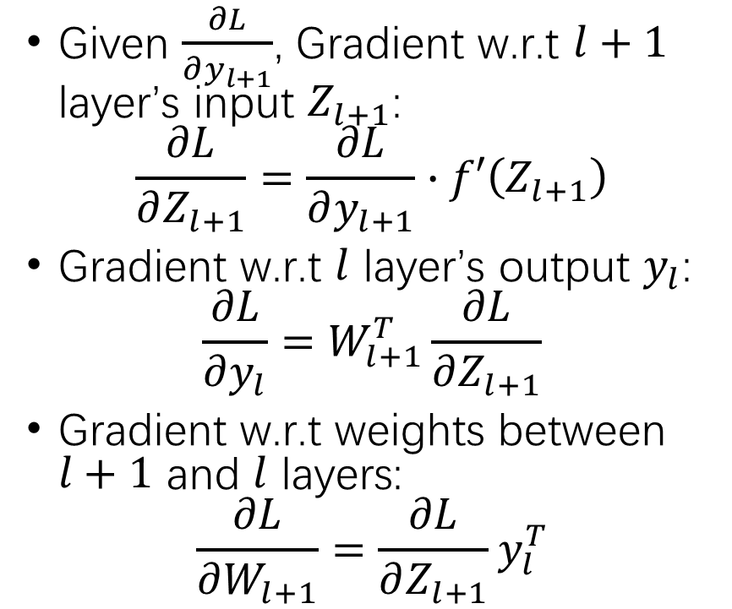
Back Propagation - Formulas
Given $\frac{∂L}{∂y_{l+1}}$, Gradient w.r.t $l+1$ layer’s input $Z_{l+1}$:
$$\frac{∂L}{∂Z_{l+1}}=\frac{∂L}{∂y_{l+1}}∙f′\left(Z_{l+1}\right)$$
Gradient w.r.t $l$ layer’s output $y_{l}$:
$$\frac{∂L}{∂y_{l}}=W_{l+1}^{T}\frac{∂L}{∂Z_{l+1}}$$
Gradient w.r.t weights between $l+1$ and $l$ layers:
$$\frac{∂L}{∂W_{l+1}}=\frac{∂L}{∂Z_{l+1}}y_{l}^{T}$$

Slide 18
Tricks/Enhancements to Speed Up GD
Momentum: P19-20
Nesterov’s Accelerated Gradient: P21
RMSprop: P22-23
Adam: P24-27

Slide 19
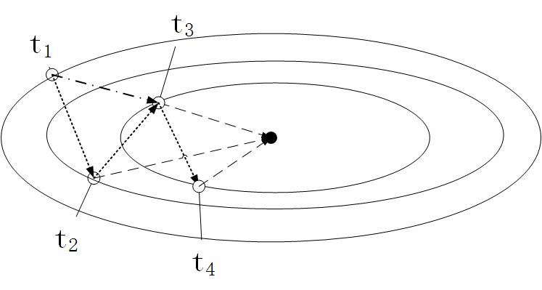
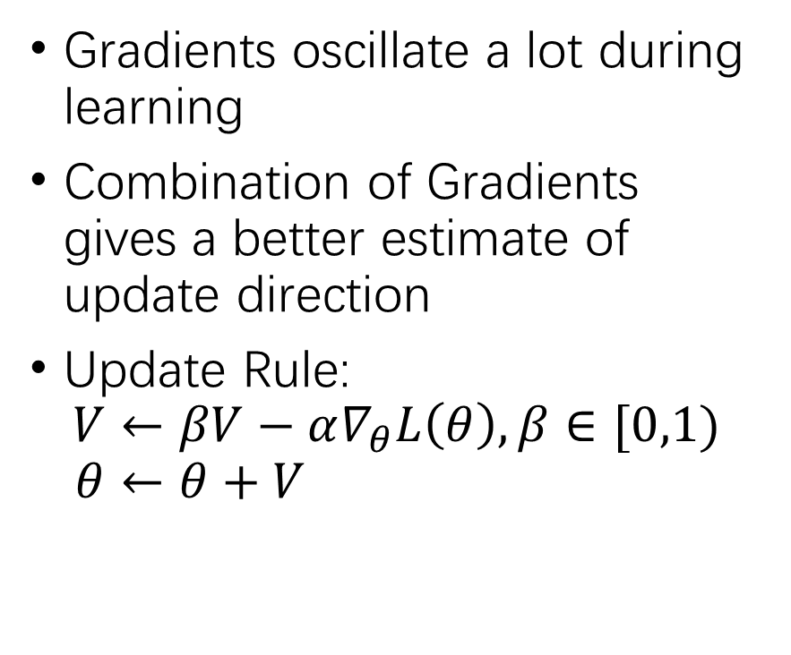
Momentum - Motivation
Combination of 2 Gradients
Gradients oscillate a lot during learning
Combination of Gradients gives a better estimate of update direction
Update Rule:
$$V←βV−α∇_{θ}L\left(θ\right),β∈[0,1)$$
$$θ←θ+V$$
Optimal Direction
Gradient

Slide 20
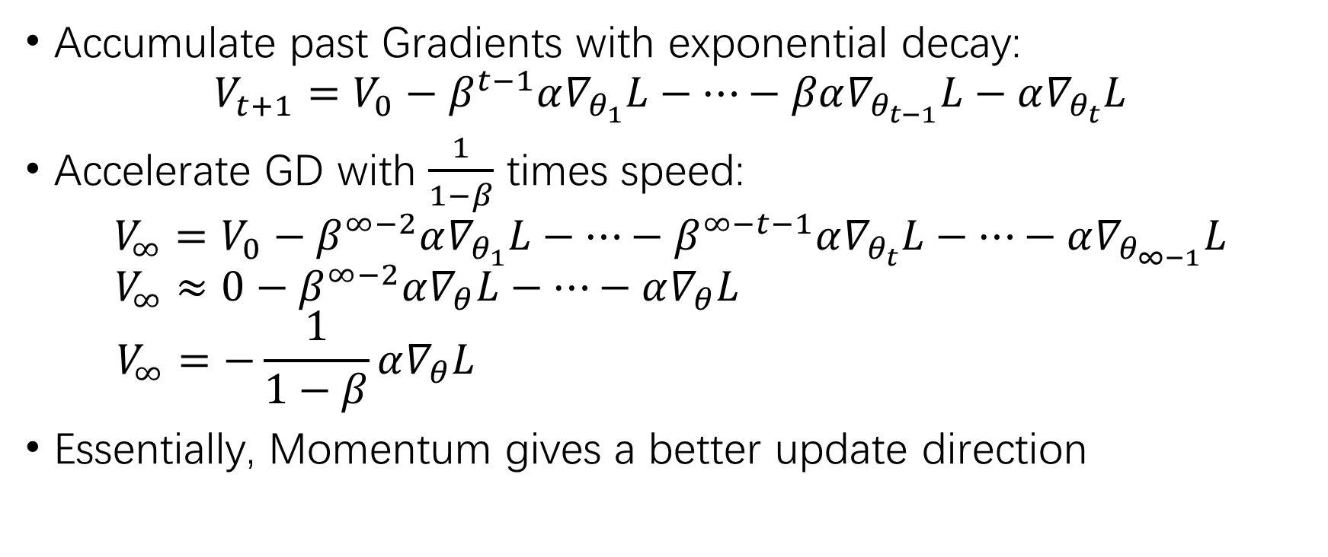
Momentum - Analysis
Accumulate past Gradients with exponential decay:
$$V_{t+1}=V_{0}−β^{t−1}α∇_{θ_{1}}L−…−βα∇_{θ_{t−1}}L−α∇_{θ_{t}}L$$
Accelerate GD with $\frac{1}{1−β}$ times speed:
$$V_{∞}=V_{0}−β^{∞−2}α∇_{θ_{1}}L−…−β^{∞−t−1}α∇_{θ_{t}}L−…−α∇_{θ_{∞−1}}L$$
$$V_{∞}≈0−β^{∞−2}α∇_{θ}L−…−α∇_{θ}L$$
$$V_{∞}=−\frac{1}{1−β}α∇_{θ}L$$
Essentially, Momentum gives a better update direction

Slide 21
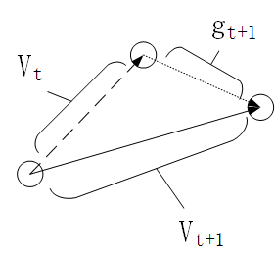
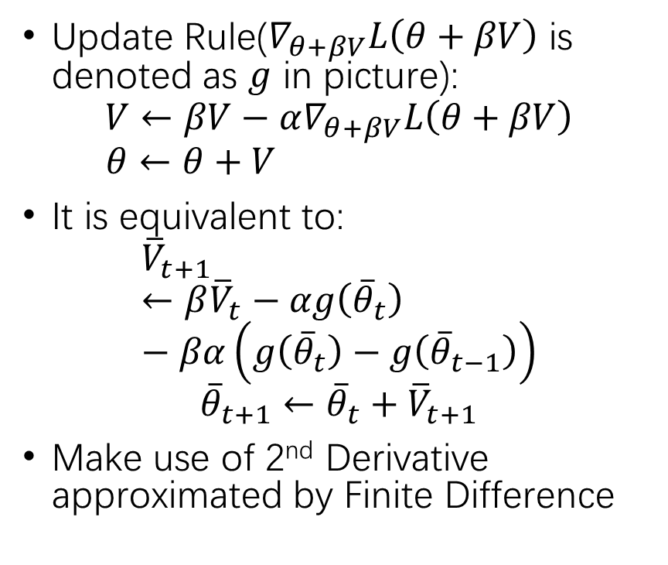
Nesterov’s Accelerated Gradient
Update Rule($∇_{θ+βV}L\left(θ+βV\right)$ is denoted as $g$ in picture):
$$V←βV−α∇_{θ+βV}L\left(θ+βV\right)$$
$$θ←θ+V$$
It is equivalent to:
$${\overline{V}}_{t+1}←β{\overline{V}}_{t}−αg\left({\overline{θ}}_{t}\right)−βα\left(g\left({\overline{θ}}_{t}\right)−g\left({\overline{θ}}_{t−1}\right)\right)$$
$${\overline{θ}}_{t+1}←{\overline{θ}}_{t}+{\overline{V}}_{t+1}$$
Make use of 2nd Derivative approximated by Finite Difference

Slide 22
RMSprop - Motivation
The size of update in GD is determined by:
Learning rate
Size of Gradient(vary all the times)
Hard to set an universal learning rate to make all updates’ size consisted
Noted that only sign of Gradient is crucial

Slide 23
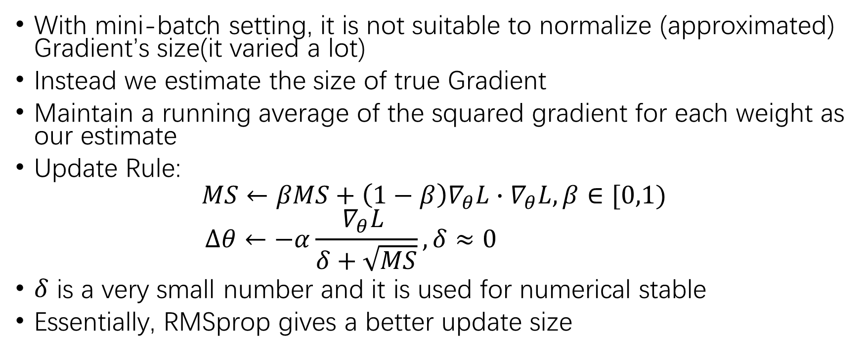
RMSprop - Details
With mini-batch setting, it is not suitable to normalize (approximated) Gradient’s size(it varied a lot)
Instead we estimate the size of true Gradient
Maintain a running average of the squared gradient for each weight as our estimate
Update Rule:
$$MS←βMS+\left(1−β\right)∇_{θ}L∙∇_{θ}L,β∈[0,1)$$
$$∆θ←−α\frac{∇_{θ}L }{δ+\sqrt{MS}},δ≈0$$
$δ$ is a very small number and it is used for numerical stable
Essentially, RMSprop gives a better update size

Slide 24
Adam - Motivation
SGD is slow: Noise in estimated Gradient’s direction
SGD is sensitive to learning rate: Noise in estimated Gradient’s size
Momentum gives a better update direction
RMSprop gives robustness to estimated Gradient’s size
How to effectively combine two of them?

Slide 25
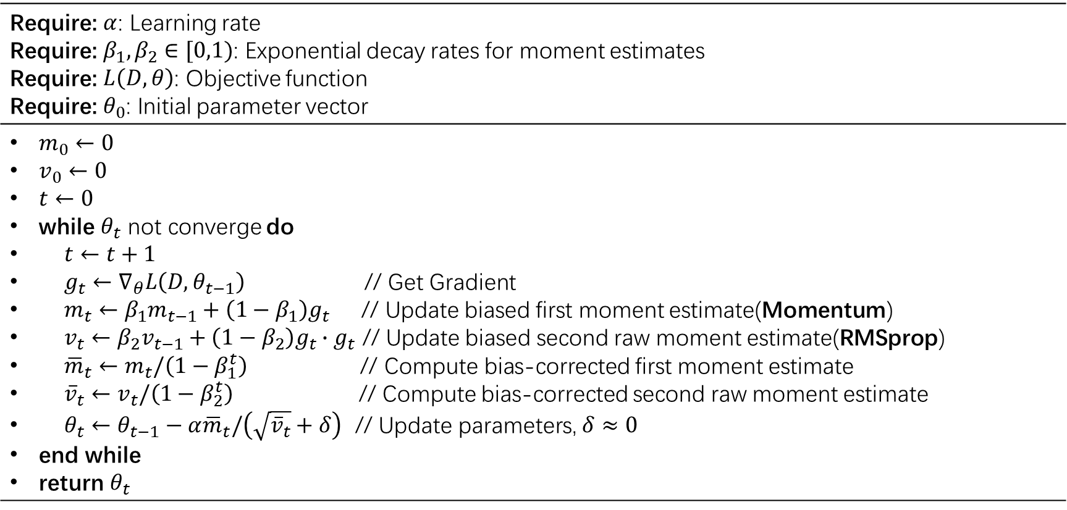
Adam - Algorithm
Require: $α$: Learning rate Require: $β_{1},β_{2}∈[0,1)$: Exponential decay rates for moment estimates Require: $L\left(D,θ\right)$: Objective function Require: $θ_{0}$: Initial parameter vector
$m_{0}←0$ $v_{0}←0$ $t←0$ while $θ_{t}$ not converge do $t←t+1$ $g_{t}←∇_{θ}L\left(D,θ_{t−1}\right)$ // Get Gradient $m_{t}←β_{1}m_{t−1}+\left(1−β_{1}\right)g_{t}$ // Update biased first moment estimate(Momentum) $v_{t}←β_{2}v_{t−1}+\left(1−β_{2}\right)g_{t}∙g_{t}$ // Update biased second raw moment estimate(RMSprop) ${\overline{m}}_{t}←m_{t}/\left(1−β_{1}^{t}\right)$ // Compute bias-corrected first moment estimate ${\overline{v}}_{t}←v_{t}/\left(1−β_{2}^{t}\right)$ // Compute bias-corrected second raw moment estimate $θ_{t}←θ_{t−1}−α{\overline{m}}_{t}/\left(\sqrt{{\overline{v}}_{t}}+δ\right)$ // Update parameters, $δ≈0$ end while return $θ_{t}$

Slide 26
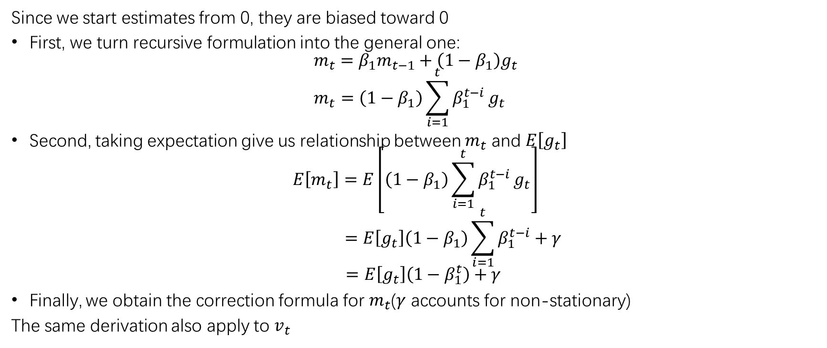
Adam - Analysis
Since we start estimates from 0, they are biased toward 0
First, we turn recursive formulation into the general one:
$$m_{t}=β_{1}m_{t−1}+\left(1−β_{1}\right)g_{t}$$
$$m_{t}=\left(1−β_{1}\right)\sum_{i=1}^{t}{β_{1}^{t−i}}g_{t}$$
Second, taking expectation give us relationship between $m_{t}$ and $E\left[g_{t}\right]$
$$E\left[m_{t}\right]=E\left[\left(1−β_{1}\right)\sum_{i=1}^{t}{β_{1}^{t−i}}g_{t}\right]$$
$$=E\left[g_{t}\right]\left(1−β_{1}\right)\sum_{i=1}^{t}{β_{1}^{t−i}}+γ$$
$$=E\left[g_{t}\right]\left(1−β_{1}^{t}\right)+γ$$
Finally, we obtain the correction formula for $m_{t}$($γ$ accounts for non-stationary)
The same derivation also apply to $v_{t}$

Slide 27
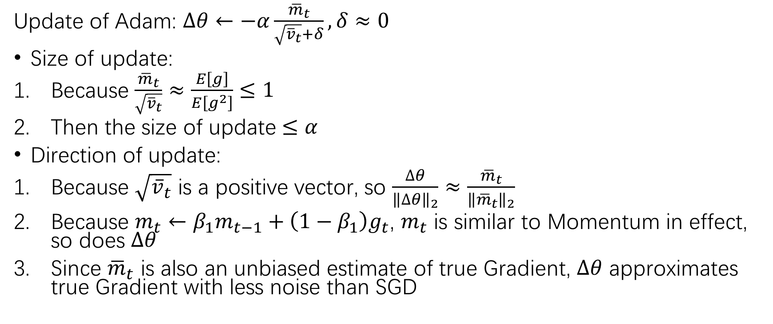
Adam - Effect
Update of Adam: $∆θ←−α\frac{{\overline{m}}_{t}}{\sqrt{{\overline{v}}_{t}}+δ},δ≈0$
Size of update:
Because $\frac{{\overline{m}}_{t}}{\sqrt{{\overline{v}}_{t}}}≈\frac{E\left[g\right]}{E\left[g^{2}\right]}≤1$
Then the size of update $≤α$
Direction of update:
Because $\sqrt{{\overline{v}}_{t}}$ is a positive vector, so $\frac{∆θ}{{\left\|∆θ\right\|}_{2}}≈\frac{{\overline{m}}_{t}}{{\left\|{\overline{m}}_{t}\right\|}_{2}}$
Because $m_{t}←β_{1}m_{t−1}+\left(1−β_{1}\right)g_{t}$, $m_{t}$ is similar to Momentum in effect, so does $∆θ$
Since ${\overline{m}}_{t}$ is also an unbiased estimate of true Gradient, $∆θ$ approximates true Gradient with less noise than SGD

Slide 28
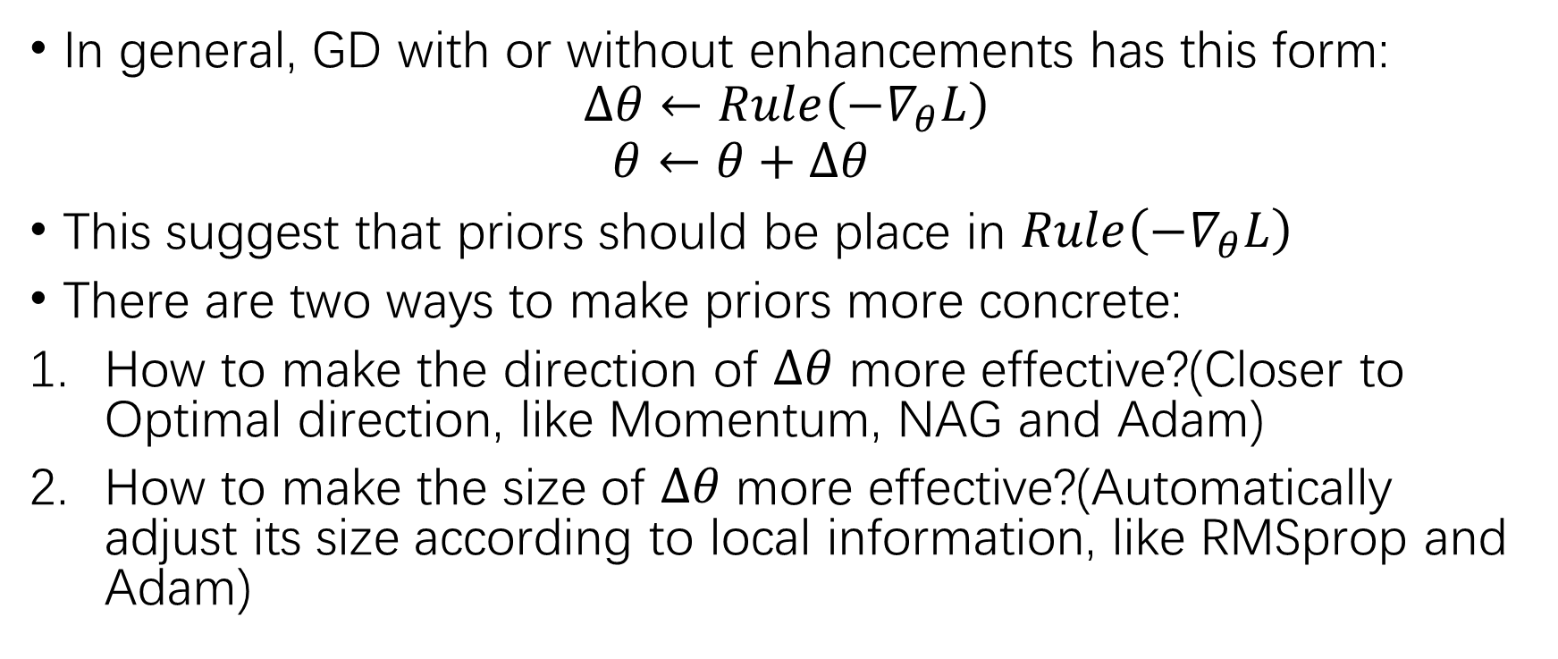
Two Ways to Inject Priors in GD
In general, GD with or without enhancements has this form:
$$∆θ←Rule\left(−∇_{θ}L\right)$$
$$θ←θ+∆θ$$
This suggest that priors should be place in $Rule\left(−∇_{θ}L\right)$
There are two ways to make priors more concrete:
How to make the direction of $∆θ$ more effective?(Closer to Optimal direction, like Momentum, NAG and Adam)
How to make the size of $∆θ$ more effective?(Automatically adjust its size according to local information, like RMSprop and Adam)

Slide 29
Assignment
Read Chapter 7, 8 of Deep Learning, Goodfellow et al., 2016.
Derive Gradient of biases (vectorization version)
Hand in lecture notes

Slide 30
Thank you!
Send me emails for potential mistakes.

